Slide 1




Impact of Wind and Ice Biases on the Southern Ocean Carbon and Heat Uptake
Jessica Rudd
Joellen Russell, Ph.D. & Paul Goodman, Ph.D.
Department of Geosciences, University of Arizona
NASA Space Grant Symposium
University of Arizona, Tucson, AZ
April 12, 2014

Slide 2
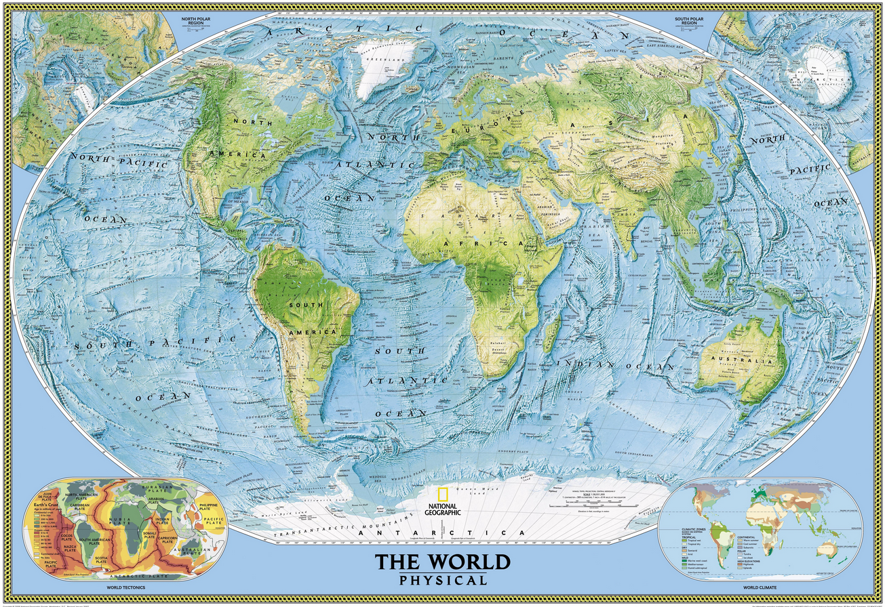
Where is the Southern Ocean?
National Geographic

Slide 3
Beginning Questions
How does the Southern Ocean (SO) play a vital role in climate and how can it impact the future?
  SO may account for up to half of the annual ocean uptake of anthropogenic carbon dioxide from the atmosphere (cf., Gruber et al., 2009)
  SO may account for up to 70 ± 30% of excess heat that is transferred from the atmosphere into the ocean each year (see analysis of IPCC AR4 models)
  SO winds and buoyancy fluxes are the principal source of energy for driving the large scale deep meridional overturning circulation throughout the ocean (e.g., Toggweiler and Samuels, 1998; Marshall and Speer, 2012)
How well are the models doing compared to observations?
Notes:
Or do we want next slide?

Slide 4
The global energy imbalance goes into the ocean
Box 3.1, Figure 1: Plot of energy accumulation within distinct components of Earth’s climate system relative to 1971.
IPCC AR5 - 2013
Skepticalscience.com

Slide 5
Global Ocean Circulation
Talley, 2013

Slide 6
Methods
What is a Global Climate Model?
  Computer code that solves differential equations of motion and thermodynamics to obtain time and space dependent values for temperature, velocity, moisture, pressure, etc. Climate models simulate the atmosphere, ocean, land surface and sea ice.
Observations used
  Climate Forecast System Reanalysis (CFSR)
  World Ocean Atlas 2009 (WOA09)
Models used
  Commonwealth Scientific and Industrial Research Organisation (CSIRO)
  Geophysical Fluid Dynamics Laboratory (GFDL)
  Hadley Centre for Climate Prediction and Research (Hadley)
  Model for Interdisciplinary Research on Climate (MIROC)
  Meteorological Research Institute (MRI)

Slide 7
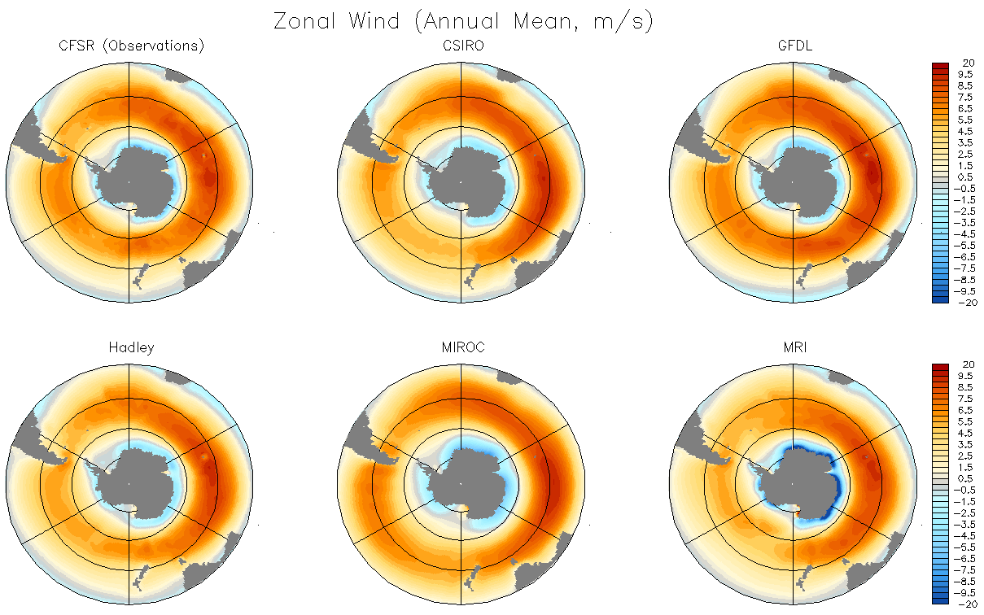
Zonal Wind Speed (m/s)

Slide 8
Zonal Wind Speed (m/s)

Slide 9
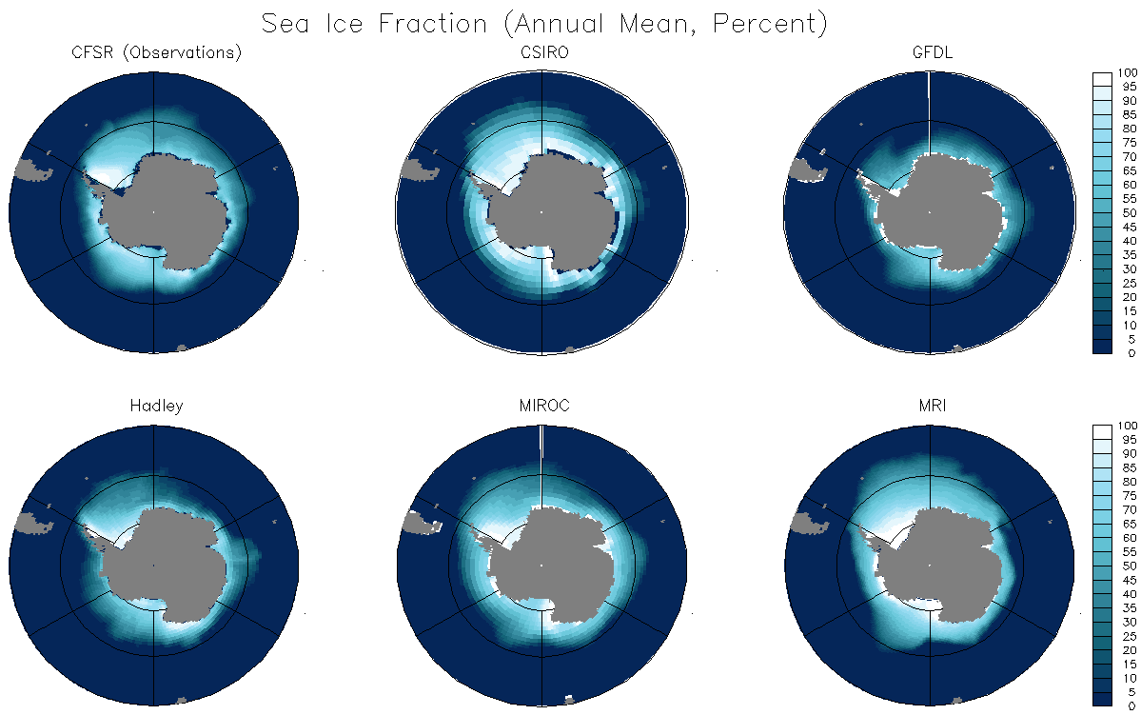
Sea Ice Fraction (Annual Mean, Percent)

Slide 10
Sea Ice Fraction (Annual Mean, Percent)

Slide 11
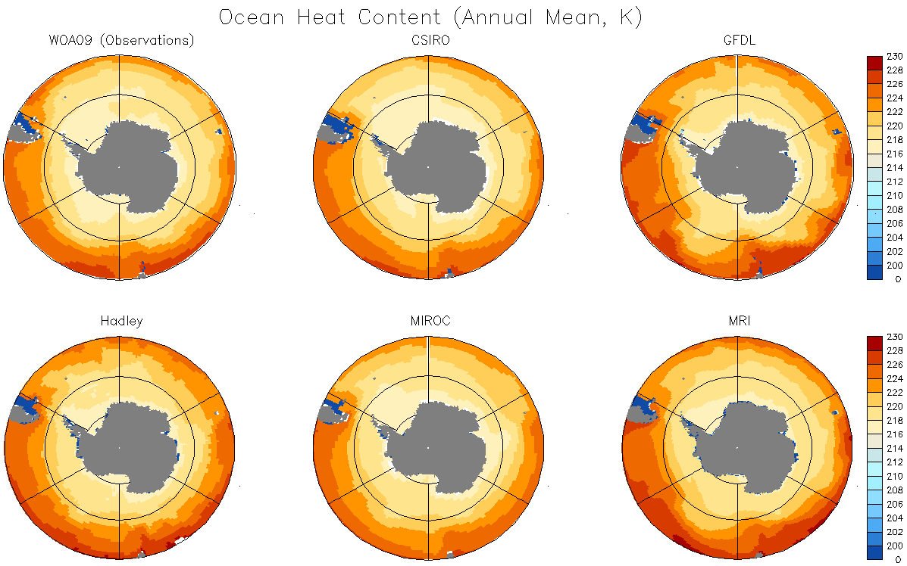
Ocean Heat Content (0-200m, 10⁹ J/m²)

Slide 12
Ocean Heat Content (0-200m, 10⁹ J/m²)

Slide 13
Summary
Conclusions
  Models have improved over the years, but further work is still needed to be able to predict the details of the future global climate on regional scales useful for planners and policy makers
Next Steps
  Continue to look at models as new data and improvements come out
  Study the winds and stratification of the SO to look at future carbon uptake

Slide 14
Acknowledgements
Timothy Swindle, Ph.D., Barron Orr, Ph.D., Susan Brew, Chandra Collins and all of the Arizona Space Grant Consortium
Arizona Space Grant Advisors, Leah Edward and John Hottenstein

